Slide 1

SOCIONICS
All slides are copyrighted by Jack Oliver Aaron of the World Socionics Society
A CRASH COURSE

Slide 2
ELEMENTS Part I
All slides are copyrighted by Jack Oliver Aaron of the World Socionics Society

Slide 3
WHAT IS SOCIONICS?
All slides are copyrighted by Jack Oliver Aaron of the World Socionics Society
A theory of…
Social Interactions

Slide 4
WHAT IS SOCIONICS?
All slides are copyrighted by Jack Oliver Aaron of the World Socionics Society
A theory of…
Social Interactions
Personality Type

Slide 5
WHAT IS SOCIONICS?
All slides are copyrighted by Jack Oliver Aaron of the World Socionics Society
A theory of…
Social Interactions
Personality Type
Cognitive Processing

Slide 6
WHAT IS SOCIONICS?
All slides are copyrighted by Jack Oliver Aaron of the World Socionics Society
A theory of…
Social Interactions
Personality Type
Cognitive Processing
Information

Slide 7
WHAT IS SOCIONICS?
All slides are copyrighted by Jack Oliver Aaron of the World Socionics Society
A theory of…
Social Interactions
Personality Type
Cognitive Processing
Information
Everything

Slide 8
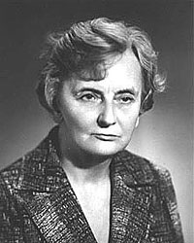
Who came up with Socionics?
All slides are copyrighted by Jack Oliver Aaron of the World Socionics Society
Aušra Augustinavičiūtė (1927 - 2005)
Pronounced “A-ow-sh-ra A-ow-gus-tee-na-vitch-oot-eer”
Lithuanian economist and dean of the family science department at Vilnius Pedagogical University
Created Socionics to help explain relationship with her husband
Gives her initial to Model ‘A’

Slide 9
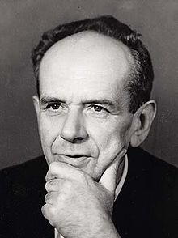
Key Influences
All slides are copyrighted by Jack Oliver Aaron of the World Socionics Society
Antoni Ignacy Tadeusz Kępiński (1918 - 1972)
Pronounced “An-tow-nee Kem-pi–ni-ya-skee”
Polish psychologist and philosopher
Founded axiological psychiatry
Originated two key ideas of Socionics:
Information Metabolism
Hierarchy of Values

Slide 10
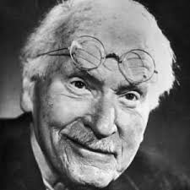
Key Influences
All slides are copyrighted by Jack Oliver Aaron of the World Socionics Society
Carl Gustav Jung (1875 - 1961)
Pronounced “Ka-arl Goo-stuff Eey-oong”
Swiss psychiatrist and psychoanalyst
Founded analytical psychology and wrote Psychological Types, the basis of Socionics and MBTI
First to discover ‘cognitive functions’
Used cognitive functions to frame personality type

Slide 11
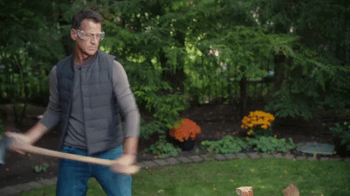

What is a Dichotomy?
All slides are copyrighted by Jack Oliver Aaron of the World Socionics Society
Literally ‘cut in two’
Understand the world in binary
Is that so controversial?
No. of dichotomies = No. of things - 1

Slide 12
INFORMATION DICHOTOMIES
All slides are copyrighted by Jack Oliver Aaron of the World Socionics Society
Perception vs. Judgement
External vs. Internal
Involved vs. Detached
ONTOLOGICAL

Slide 13
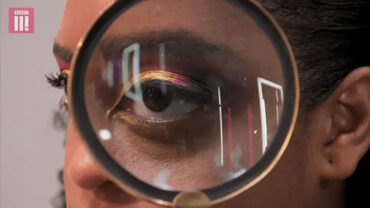
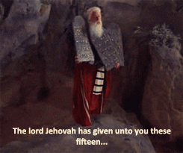
PERCEPTION VS. JUDGEMENT
All slides are copyrighted by Jack Oliver Aaron of the World Socionics Society
Perception | Judgement
Descriptive What things are, may have been, will be, or could be Called ‘irrational’ by Jung | Prescriptive How things should be, what ought to be, if X is good or bad Called ‘rational’ by Jung

Slide 14
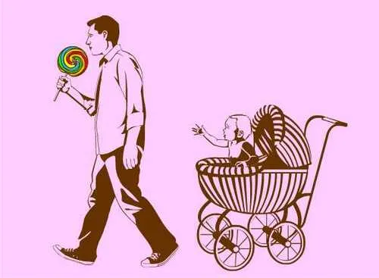
PERCEPTION VS. JUDGEMENT
All slides are copyrighted by Jack Oliver Aaron of the World Socionics Society
What is this?
Perception: A man taking candy from a baby.
Judgement: Disgraceful!!!

Slide 15
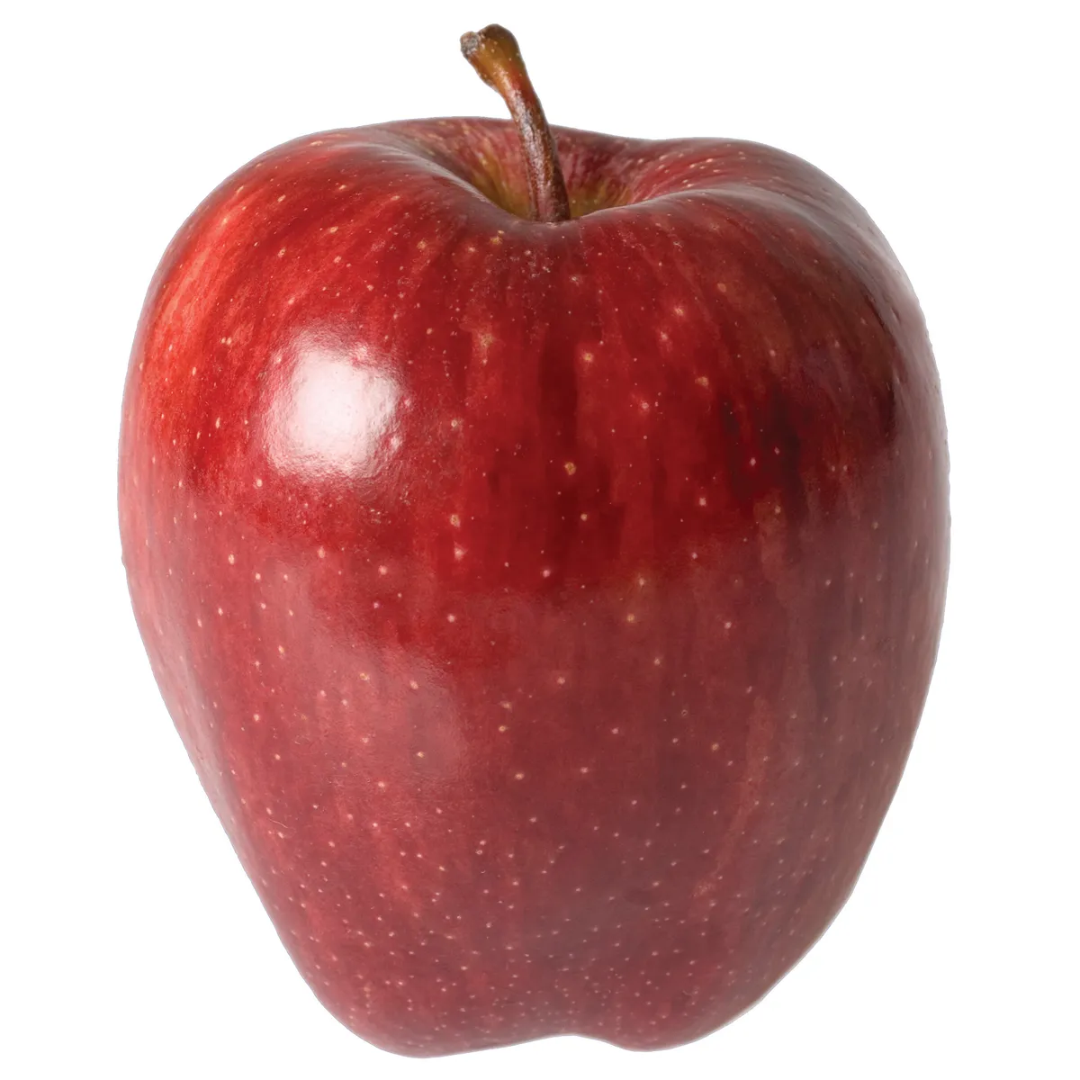

EXTERNAL VS. INTERNAL
All slides are copyrighted by Jack Oliver Aaron of the World Socionics Society
External | Internal
Objective or Explicit Instantly shareable as it is Exists independently of people | Subjective or Implicit Interpreted in the mind’s eye Without people, it wouldn’t exist

Slide 16
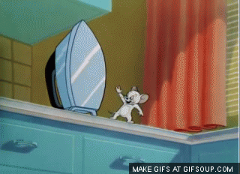
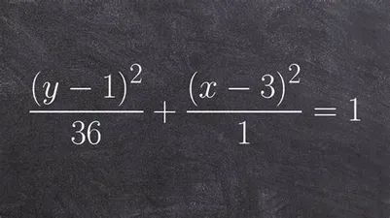
INVOLVED VS. DETACHED
All slides are copyrighted by Jack Oliver Aaron of the World Socionics Society
Involved | Detached
Vivaciously felt Cannot ignore it Brings pain or pleasure | Numbly thought about Requires concentration Remains impartial

Slide 17
4 INFORMATION DOMAINS
All slides are copyrighted by Jack Oliver Aaron of the World Socionics Society
 | External | Internal
Involved | Sensation | Ethics
Detached | Logic | Intuition
 | External | Internal
Judgement | Logic | Ethics
Perception | Sensation | Intuition

Slide 18
PERCEPTIONS
All slides are copyrighted by Jack Oliver Aaron of the World Socionics Society
Sensation
Intuition

Slide 19

SENSATION
All slides are copyrighted by Jack Oliver Aaron of the World Socionics Society
Perception, External and Involved
What is
Grounded in the present
Real and concrete
Specific details
Perceived via the five senses
Source of physical pleasure or pain

Slide 20
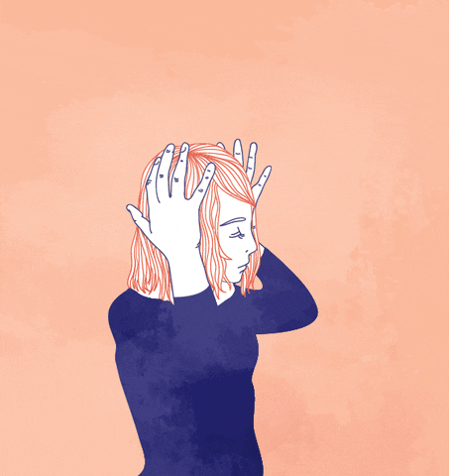
INTUITION
All slides are copyrighted by Jack Oliver Aaron of the World Socionics Society
Perception, Internal and Detached
What could be
Imagined about past, future or fantasy
Intangible and abstract
General trends
Perceived in the mind’s eye
Has no effect on the body

Slide 21
JUDGEMENTS
All slides are copyrighted by Jack Oliver Aaron of the World Socionics Society
Logic
Ethics

Slide 22
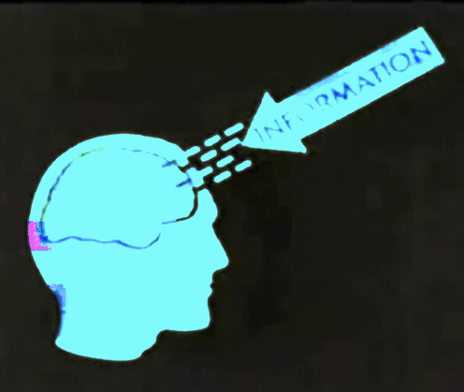
LOGIC
All slides are copyrighted by Jack Oliver Aaron of the World Socionics Society
Judgement, External and Detached
What makes sense (or not)
Grounded in rules or facts
Impartial and objective
Propositions of truth
Concluded by a process of reasoning
Arrived at dispassionately

Slide 23

ETHICS
All slides are copyrighted by Jack Oliver Aaron of the World Socionics Society
Judgement, Internal and Involved
What feels good (or not)
Ordained by the ‘soul’
Partial and subjective
Inner sentiments
Instantly felt before it can be processed
Experienced vivaciously

Slide 24
INFORMATION DICHOTOMIES
All slides are copyrighted by Jack Oliver Aaron of the World Socionics Society
Perception vs. Judgement
Internal vs. External
Involved vs. Detached
Extroverted vs. Introverted
Static vs. Dynamic
STYLISTIC

Slide 25
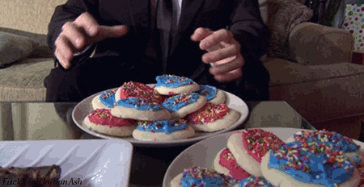

EXTROVERTED VS. INTROVERTED
All slides are copyrighted by Jack Oliver Aaron of the World Socionics Society
Extroverted | Introverted
Turns out from itself Maximises quantity Breadth-oriented Accumulates more and more things | Turns into itself Refines quality Depth-oriented Integrates what is there, ties loose ends

Slide 26
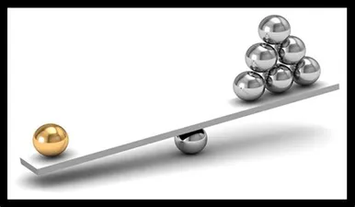
EXTROVERTED VS. INTROVERTED
All slides are copyrighted by Jack Oliver Aaron of the World Socionics Society
Extroverted
Introverted

Slide 27
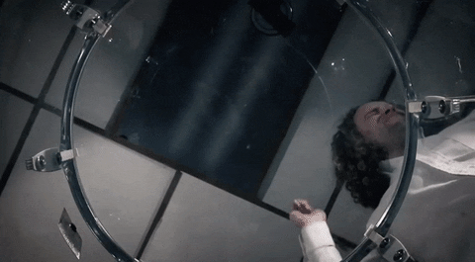

STATIC VS. DYNAMIC
All slides are copyrighted by Jack Oliver Aaron of the World Socionics Society
Static | Dynamic
Stays the same, until sudden jump Sudden, complete changes Each part distinct and separate | Constantly moving Always gradually changing No clear boundaries, holistic

Slide 28

STATIC VS. DYNAMIC
All slides are copyrighted by Jack Oliver Aaron of the World Socionics Society
Static
Dynamic

Slide 29
4 Information Styles
All slides are copyrighted by Jack Oliver Aaron of the World Socionics Society
 | Extroverted | Introverted
Static | Erratic | Fixed
Dynamic | Relentless | Tranquil
 | Extroverted | Introverted
Judgement | Relentless | Fixed
Perception | Erratic | Tranquil

Slide 30

ERRATIC
All slides are copyrighted by Jack Oliver Aaron of the World Socionics Society
Perception, Extroverted and Static
Jumps unpredictably all over the place
Comprises many, different objects to acquire
Fickle in focus and hungry for more and more
Also called “flexible-maneuvering”

Slide 31

TRANQUIL
All slides are copyrighted by Jack Oliver Aaron of the World Socionics Society
Perception, Introverted and Dynamic
Gradually shifting and adjusting to balance
Comprises fields that are acted upon
Refines quality of input it passively receives
Also called “receptive-adaptive”

Slide 32
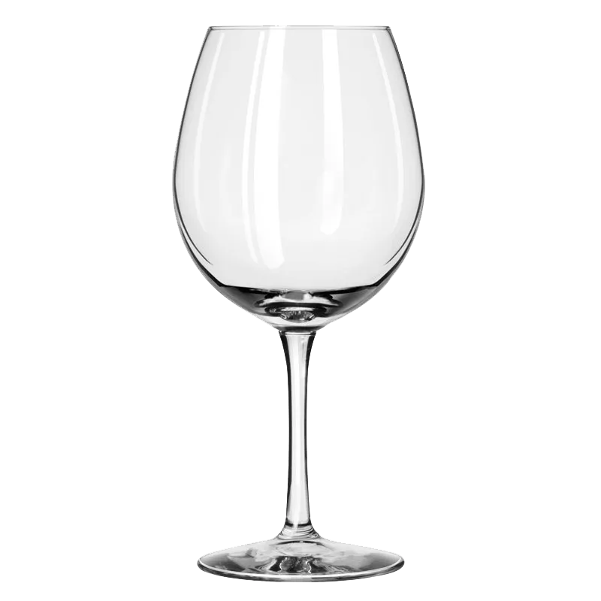
FIXED
All slides are copyrighted by Jack Oliver Aaron of the World Socionics Society
Judgement, Introverted and Static
Remains unbending, until it breaks
Comprises fixed ties and arrangements
Keeps faith with conviction
Also called “balanced-stable”

Slide 33
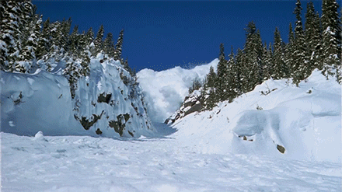
RELENTLESS
All slides are copyrighted by Jack Oliver Aaron of the World Socionics Society
Judgement, Extroverted and Dynamic
Continuously purposeful and on the move
Comprises ongoing, transformative processes
Always something to do in each situation
Also called “linear-assertive”

Slide 34

INFORMATION DICHOTOMIES
All slides are copyrighted by Jack Oliver Aaron of the World Socionics Society
Perception vs. Judgement
Internal vs. External
Involved vs. Detached
Introverted vs. Extraverted
Static vs. Dynamic
Attractive vs. Repulsive
Questionable vs. Conclusive
ATTITUDINAL

Slide 35
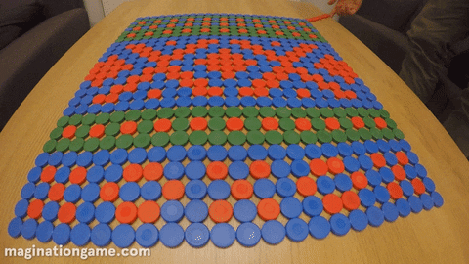
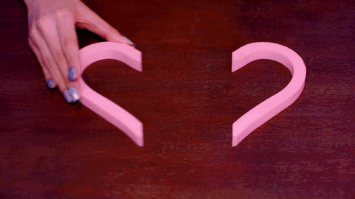
ATTRACTIVE VS. REPULSIVE
All slides are copyrighted by Jack Oliver Aaron of the World Socionics Society
Attractive | Repulsive
Information is brought together Commonality to be found Things will perfectly align | Information is pushed apart Differences are to be found Things will never align

Slide 36
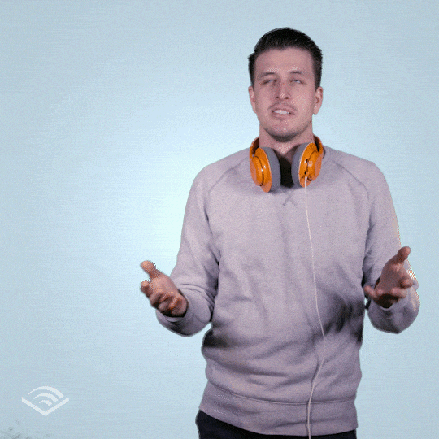
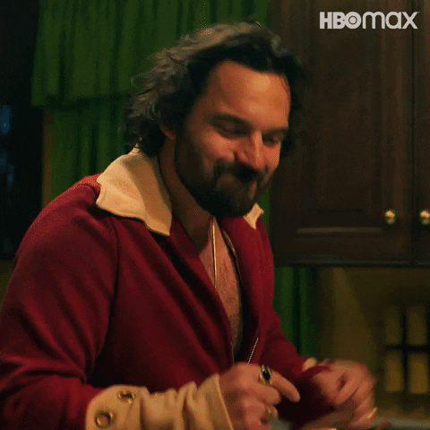
QUESTIONABLE VS. CONCLUSIVE
All slides are copyrighted by Jack Oliver Aaron of the World Socionics Society
Questionable | Conclusive
Remains unfinished Always more nuance to find Keeps waiting and seeing | Seeks certainty and finality No ifs, no buts, this is or isn’t it Creates lasting impact

Slide 37


APPRECIATING
All slides are copyrighted by Jack Oliver Aaron of the World Socionics Society
Perception, Attractive and Questionable
Explore and harmonise experiences
Stay open and receptive, give things a chance
Embrace and appreciate existence

Slide 38
4 Information Attitudes
All slides are copyrighted by Jack Oliver Aaron of the World Socionics Society
 | Questionable | Conclusive
Attractive | Appreciating | Resolving
Repulsive | Differentiating | Repudiating
 | Questionable | Conclusive
Judgement | Differentiating | Resolving
Perception | Appreciating | Repudiating

Slide 39
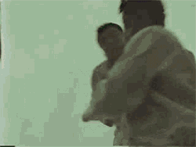
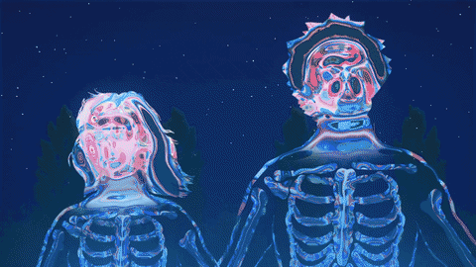
REPUDIATING
All slides are copyrighted by Jack Oliver Aaron of the World Socionics Society
Perception, Repulsive and Conclusive
See the world as a challenge to overcome
Be dissatisfied and demand more
Overcome existence

Slide 40
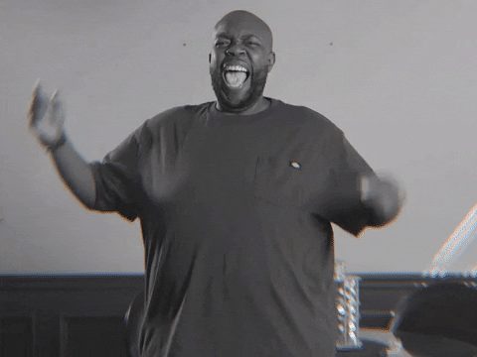
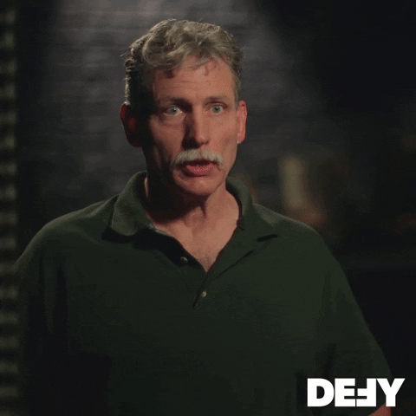
RESOLVING
All slides are copyrighted by Jack Oliver Aaron of the World Socionics Society
Judgement, Attractive and Conclusive
Make things clear and unambiguous
Show how everything fits together
Unite everything in what should be

Slide 41
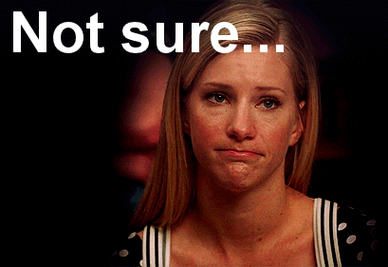
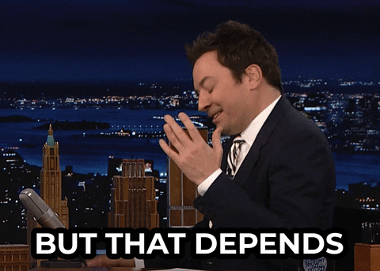
DIFFERENTIATING
All slides are copyrighted by Jack Oliver Aaron of the World Socionics Society
Judgements, Repulsive and Questionable
Unveil complexity, nuance and uncertainty
Show how nothing is ever so simple
Treat each conclusion as specific to the situation

Slide 42
What we learned…
All slides are copyrighted by Jack Oliver Aaron of the World Socionics Society
Dichotomies | Qualities
Perception + External + Involved | Sensation
Perception + Internal + Detached | Intuition
Judgement + External + Detached | Logic
Judgement + Internal + Involved | Ethics
Perception + Extroverted + Static | Erratic
Perception + Introverted + Dynamic | Tranquil
Judgement + Extroverted + Dynamic | Relentless
Judgement + Introverted + Static | Fixed
Perception + Attractive + Questionable | Appreciating
Perception + Repulsive + Conclusive | Repudiating
Judgement + Attractive + Conclusive | Resolving
Judgement + Repulsive + Questionable | Differentiating
 | Information
1 | Perception | Judgement
2 | External | Internal
3 | Detached | Involved
4 | Extroverted | Introverted
5 | Static | Dynamic
6 | Attractive | Repulsive
7 | Questioning | Conclusive

Slide 43
Next Time
All slides are copyrighted by Jack Oliver Aaron of the World Socionics Society
Qualities | IM Elements
Sensation + Erratic + Repudiating
Sensation + Tranquil + Appreciating
Intuition + Erratic + Appreciating
Intuition + Tranquil + Repudiating
Logic + Relentless + Differentiating
Logic + Fixed + Resolving
Ethics + Relentless + Resolving
Ethics + Fixed + Differentiating

Slide 44
Any Questions?
All slides are copyrighted by Jack Oliver Aaron of the World Socionics Society
Email Jack at worldsocionics@hotmail.com

